Slide 1

INSTITUTE - UIE
DEPARTMENT- ACADEMIC UNIT-2
Bachelor of Engineering (Computer Science & Engineering)
Subject Name: Introduction to Problem Solving
Code:23CSH-101
Introduction to computers and programming
DISCOVER . LEARN . EMPOWER

Slide 2


Introduction to Problem Solving
Course Objectives
The course aims to provide exposure to problem-solving through programming.
The course aims to raise the programming skills of students via logic building capability.
With knowledge of C programming language, students would be able to model real world problems.

Slide 3


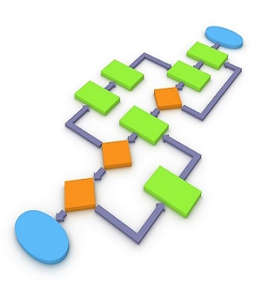
Course Outcomes
CO Number | Course Outcome
CO1 | Remember the concepts related to fundamentals of C language, draw flowcharts and write algorithm/pseudocode.
CO2 | Understand the way of execution and debug programs in C language.
CO3 | Apply various constructs, loops, functions to solve mathematical and scientific problem.
CO4 | Analyze the dynamic behavior of memory by the use of pointers.
CO5 | Design and develop modular programs for real world problems using control structure and selection structure.

Slide 4

Scheme of Evaluation

Slide 5
What ??
Electronic device
computers are electronic devices that accept data (input), process that data, produce output, and store (storage) the results.
Memory is just like a human brain. It is used to store data and instructions. Computer memory is the storage space in the computer, where data is to be processed and instructions required for processing are stored.
Why??
Make life simple
If you do not have a sufficient amount of RAM than your CPU has to work much, much harder to transfer data, which severally damages the computer's performance. Random access memory also helps your system support software.

Slide 6
Basic Applications of Computer
Home. Computers are used at homes for several purposes like online bill payment, watching movies or shows at home, home tutoring, social media access, playing games, internet access, etc.
Medical Field.
Entertainment.
Industry.
Education.
Government.
Banking.
Business.

Slide 7
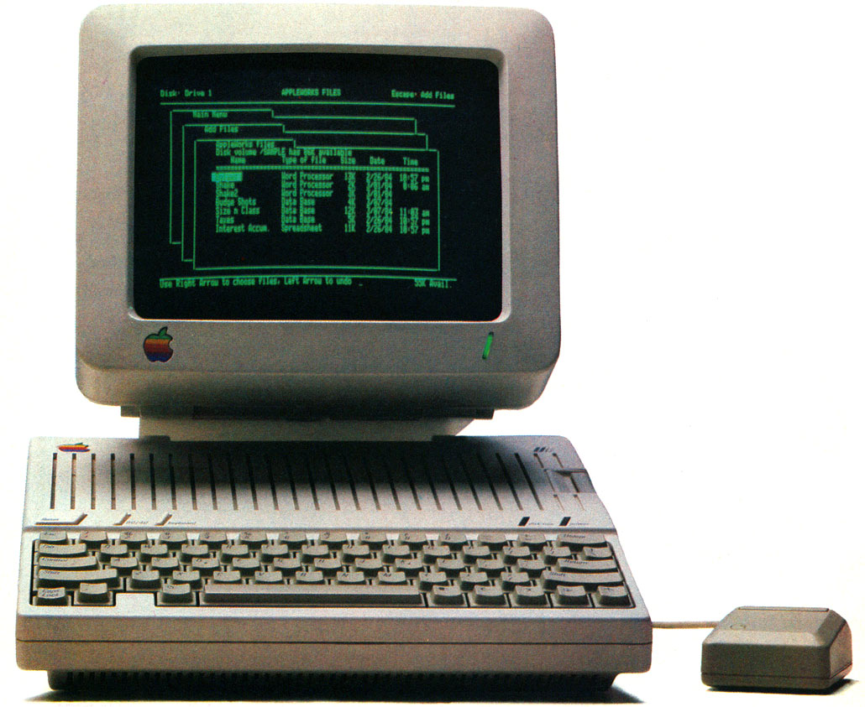
CONTENTS
Space for visual (size 24)
Introduction to computer
Internal components of CPU
Basic block diagram and functions of various components of computer
Memory
Memory layout of C program
Notes:
Computer in the diagram is 3rd generation computer. The period of third generation was from 1965-1971. The computers of third generation used Integrated Circuits (ICs) in place of transistors. A single IC has many transistors, resistors, and capacitors along with the associated circuitry. The main features of third generation are −
IC used
More reliable in comparison to previous two generations
Smaller size
Generated less heat
Faster
Lesser maintenance
Costly
AC required
Consumed lesser electricity
Supported high-level language

Slide 8
What is a Computer?
A computer is an electronic device used to store and process information.
It plays a major role in our lives.
You use computers in education and research.
You also use them for broadcasting news, receiving and sending messages to family and friends, making presentations, maintaining official and personal records, making weather forecasts, and for various other business and recreation activities.
By using computers, you save a lot of time, effort, and money.

Slide 9
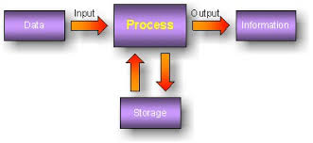
Functions of Computers
A computer is an electronic device that accepts data from the user, processes it, produces results, displays them to the users, and stores the results for future usage.
Functions:
Receiving Input
Data is fed into computer through various input devices like keyboard, mouse, digital pens, etc. Input can also be fed through devices like CD-ROM, pen drive, scanner, etc.
Processing the information
Operations on the input data are carried out based on the instructions provided in the programs.
Storing the information
After processing, the information gets stored in the primary or secondary storage area.
Producing output
The processed information and other details are communicated to the outside world through output devices like monitor, printer, etc.
Data is a collection of unorganized facts & figures and does not provide any further information regarding patterns, context, etc. Hence data means "unstructured facts and figures".
Information is a structured data i.e. organized meaningful and processed data. To process the data and convert into information, a computer is used.

Slide 10
Computer Characteristics :
Speed
A computer works with much higher speed and accuracy compared to humans while performing mathematical calculations. Computers can process millions (1,000,000) of instructions per second. The time taken by computers for their operations is microseconds and nanoseconds.
Accuracy
Computers perform calculations with 100% accuracy. Errors may occur due to data inconsistency or inaccuracy.
Diligence
A computer can perform millions of tasks or calculations with the same consistency and accuracy. It doesn’t feel any lack of concentration.
Versatility
Versatility refers to the capability of a computer to perform different kinds of works with same accuracy and efficiency.
Reliability
A computer is reliable as it gives consistent result for similar set of data i.e., if we give same set of input any number of times, we will get the same result.
Automation
Computer performs all the tasks automatically i.e. it performs tasks without manual intervention.
Memory
A computer has built-in memory called primary memory where it stores data. Secondary storage are removable devices such as CDs, pen drives, etc., which are also used to store data.

Slide 11
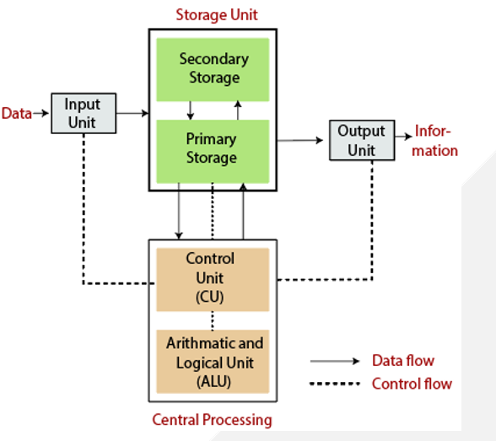
Block Diagram of Computer

Slide 12
Input Devices
The user provides the set of instruction or data to the computer system with the help of input devices such as the keyboard, mouse, scanner, etc.
There are some important features of input devices which are given below:
The input device performs like the connection between the outside world and computer system.
The input devices receive or accept the data or instruction from the user
These devices convert the data or instruction into the machine-readable form for further processing.

Slide 13
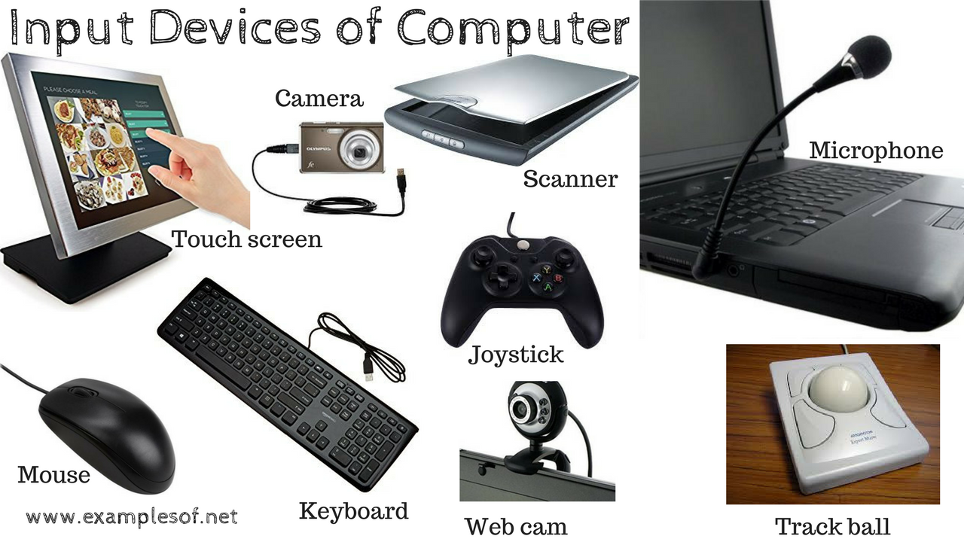

Slide 14
Memory
Primary Memory
Secondary Memory
Cache Memory

Slide 15
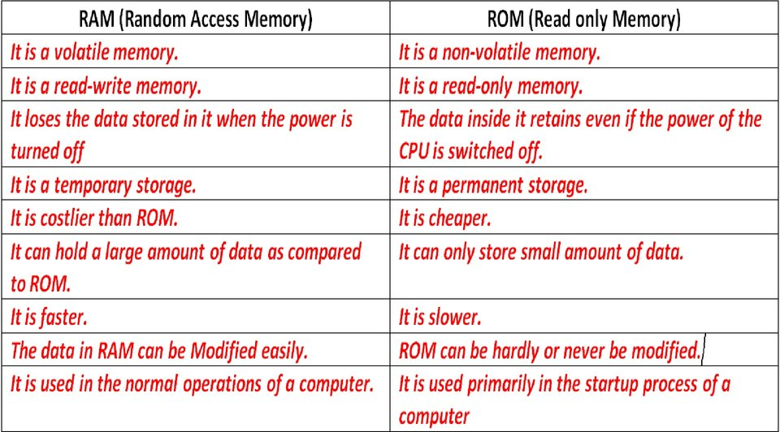
Primary Memory:
Primary memory is computer main memory that is accessed directly by the CPU. This includes several types of memory, RAM & ROM

Slide 16
Secondary memory
We can store the data and programs on a long-term basis in the secondary memory. The hard disks and the optical disks are the common secondary devices. It is slow and cheap memory as compare to primary memory. This memory is not connected to the processor directly.
It has a large capacity to store the data like 500 GB or 1 TB, The data and programs on the hard disk are organized into files, and the file is the collection of data on the disk.

Slide 17
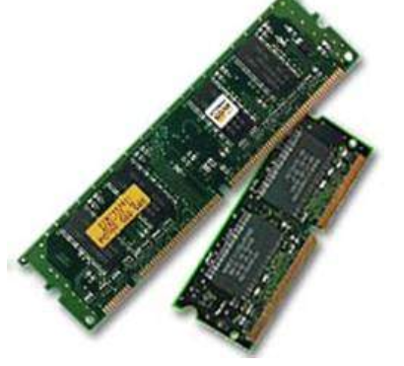
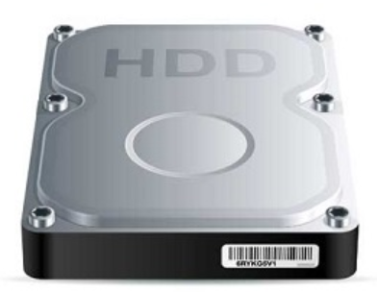
Primary Vs Secondary memory
Primary Memory | Secondary Memory
It is known as the main memory. | It is known as the backup memory.
Directly accessible by CPU | Not directly accessible by CPU
RAM is directly installed onto a motherboard | The hard disk drive is connected to the motherboard by cable
Usually volatile memory. Data is lost in case power is switched off. | It is a non-volatile memory, Data is permanently stored even if power is switched off.
It is the working memory of the computer, used for processing the data | It is used for storage of data in a computer.
Small size | Large size
A computer cannot run without the primary memory. | Computer may run without the secondary memory.
Faster than secondary memories. | Slower than primary memories

Slide 18
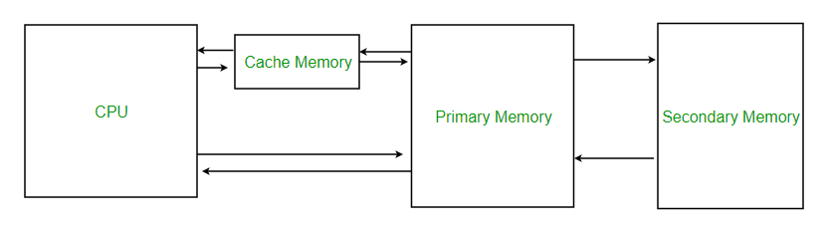
Cache Memory
Cache memory is a very high speed memory which can speed up the CPU.
It acts as a buffer between the CPU and the main memory.
It is used to hold most frequently used data, by the CPU
Advantages
Cache memory is faster than main memory.
It stores data for temporary use.
Disadvantages
Cache memory has limited capacity.
It is very expensive.

Slide 19
Central Processing Unit (CPU)
The computer system is nothing without the CPU so, it is also known as the brain of computer. The CPU is an electronic hardware device which can perform different types of operations.
The CPU contains two parts: Control Unit & Arithmetic logic unit
Control Unit
The control unit (CU) controls all the activities or operations which are performed inside the computer system
Functions of this unit are −
It is responsible for controlling the transfer of data and instructions among other units of a computer.
It manages and coordinates all the units of the computer.
It obtains the instructions from the main memory, interprets them, and directs the operation of the computer.
It communicates with Input/output devices for transfer of data or results from storage.

Slide 20
ALU (Arithmetic Logic Unit)
This unit consists of two subsections namely,
Arithmetic Section
Logic Section
Arithmetic Section
Function of arithmetic section is to perform arithmetic operations like addition, subtraction, multiplication, and division. All complex operations are done by making repetitive use of the above operations.
Logic Section
Function of logic section is to perform logic operations such as comparing, selecting, matching, and merging of data.

Slide 21
Output Devices
The output devices produce or generate the desired result according to our input, such as a printer, monitor, etc. These devices convert the data into a human-readable form from binary code.
The primary examples of output devices are a printer, projector, etc.
These devices have various features which are given below:
These devices receive or accept the data in the binary form.
The output devices convert the binary code into the human-readable form.
These devices produce the converted result and display to the user.

Slide 22
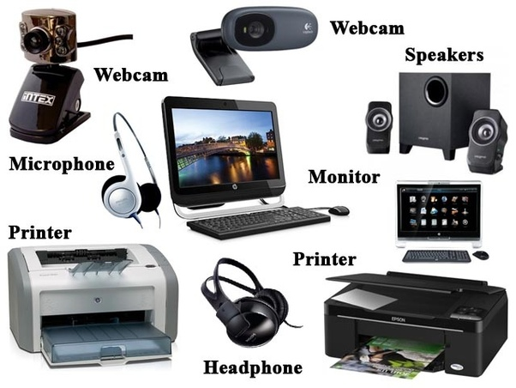

Slide 23
Summary
In this lecture we have discussed about functions of computer & computer characteristics
We have discussed about the block diagram of computer, how computer works.
We have learnt about primary and secondary memory, RAM and ROM.

Slide 24
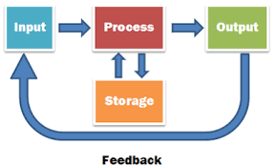
Frequently Asked question
Q1 Differentiate RAM & ROM ?
Ans. RAM and ROM are both types of computer memory. RAM is used to store computer programs and data that CPU needs in real time. RAM data is volatile and is erased once computer is switched off. ROM have prerecorded data and it is used to boot computer. RAM data is static and remains in the computer even if computer is switched off.
Q2 Differentiate Primary & Secondary memory ?
Ans. Primary memory is also called internal memory whereas Secondary memory is also known as a Backup memory or Auxiliary memory. ... Primary memory data is directly accessed by the processing unit whereas Secondary memory data cannot be accessed directly by the processor
Q3 Draw the Working of computer system?
Ans.

Slide 25
Assessment Questions:
1. Any electronic holding place where data can be stored and retrieved later whenever required is ____________ a) memory b) drive c) disk d) circuit
2. Cache memory is the onboard storage. a) True b) False
3 The memory implemented using the semiconductor chips is _________ a) Cache b) Main c) Secondary d) Registers
4. Which of the following is independent of the address bus? a) Secondary memory b) Main memory c) Onboard memory d) Cache memory

Slide 26
5. ____________ is the raw material used as input and __________ is the processed data obtained as output of data processing. a) Data, Instructions b) Instructions, Program c) Data, Program d) Program, Code
6. Which of the following is not a characteristic of a computer? a) Diligence b) I.Q. c) Accuracy d) Versatility
7. The ‘heart’ of the processor which performs many different operations _____________ a) Arithmetic and logic unit b) Motherboard c) Control Unit d) Memory
8. ALU is the place where the actual executions of instructions take place during the processing operation. a) True b) False

Slide 27

REFERENCES
Reference Books:
[1] Programming in C by Reema Thareja.
[2] Programming in ANSI C by E. Balaguruswamy, Tata McGraw Hill.
[3] Programming with C (Schaum's Outline Series) by Byron Gottfried Jitender Chhabra, Tata McGraw Hill.
[4] The C Programming Language by Brian W. Kernighan, Dennis Ritchie, Pearson education.
Websites:
https://www.tutorialandexample.com/block-diagram-of-a-computer/
https://www.tutorialspoint.com/computer_fundamentals/computer_memory.htm
https://www.geeksforgeeks.org/memory-layout-of-c-program/
YouTube Links:
https://www.youtube.com/watch?v=1owWbDQ5dJQ
https://www.youtube.com/watch?v=v9e2gaUwKf4
https://www.youtube.com/watch?v=kpWG423uQIw

Slide 28
THANK YOU

